Slide 1
National Investigation Agency
It’s a highly regarded investigative agency in India that operates under the Ministry of Home Affairs, and it was founded by Radha Vinod Raju on December 31, 2008 in accordance with the National Investigation Agency Act of 2008.
Why did it establish:-
India has been facing incidents of terrorism for many decades. From the smuggling of drugs and arms to bomb blasts and terrorist attacks, India was facing national security threats in every way. After that, recommendations were made by the Administrative Reforms Commission for the establishment of a counter-terrorism agency at the Centre. This led to the birth of the National Investigation Agency.
NIA has registered and investigated 315 cases as on date i.e. 05.02.2020. After submission of charge sheets, 60 cases have been finally or partially decided in trial. Of these, 54 cases have ended in conviction giving NIA an enviable conviction percentage of 90%
It can investigate and prosecute people for offenses specified in the NIA Act. It covers various crimes like waging war, nuclear, unlawful, hijacking, terrorist activities, and explosives.

Slide 2
Vision:-
To be a thoroughly professional investigative agency matching the best international standard to counter terrorism and other national security-related investigations at the national level. It aims to develop as a storehouse of all terrorist-related information.
Mission:-
To uncover and investigate terrorism-related cases
2. To meet the international standards of anti-terrorism organizations
3. To develop a partnership-oriented and highly trained workforce
4. To handle offenses related to the unlawful activities of individuals or groups
5. To create a database of all information related to terrorists
6. To ensure a speedy and fair trial
7. To coordinate and collaborate with state agencies in investigations
8. To give importance to human rights and the dignity of people
9. To use modern technology for the activities of NIA
10. To display scientific temper while discharging duties
11. To gain the trust of the citizens

Slide 3
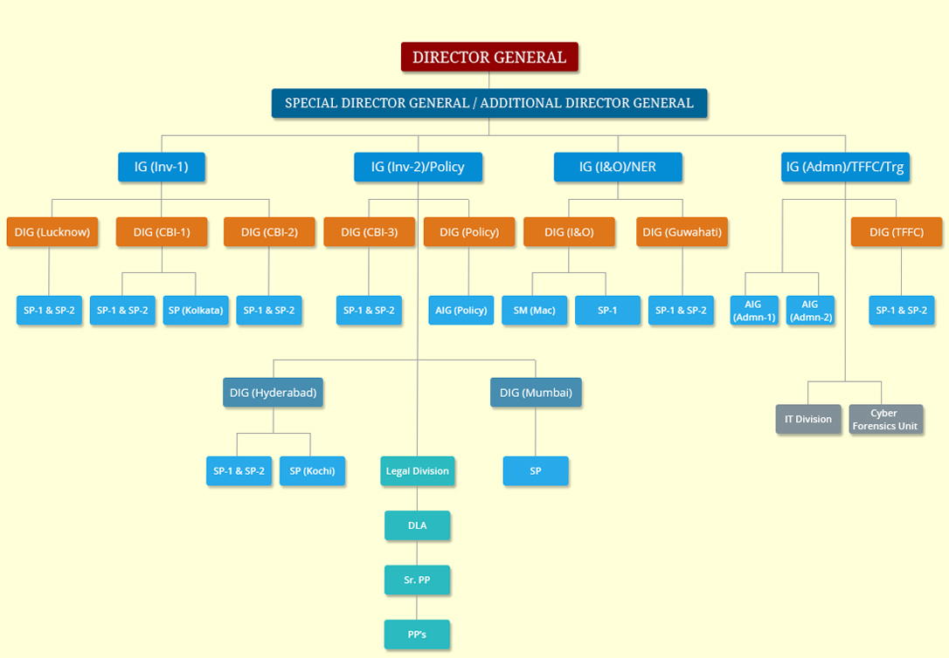

Slide 4
Organizational Structure of the NIA
A Director General heads the National Investigation Agency as NIA chief. He has the same powers as the Director General of Police. The special Director General and Additional Director General follow Director General. Primarily, it is divided into four branches. These four branches are then subdivided.
1. Inspector General of Police (Inv – 1)
This branch is divided into three posts – Deputy Inspector General of Lucknow, CBI – 1, and CBI – 2. There are two Superintendent of Police under each of these posts. However, CBI-1 also has a superintendent for Kolkata.
2. Inspector General of Police (Inv – 2 and Policy)
This branch is divided into four DIGs and one legal department. The four Deputy Inspector Generals are – CBI – 3, Hyderabad, Mumbai, and Policy. An SP follows each DIG. CBI-3 has two SPs. Hyderabad has two SPs and one for Kochi. Mumbai has one SP. The policy branch has an Assistant Inspector General and not an SP.
3. Inspector General of Police (I&O and North Eastern Region) independent intelligence and operations
This branch is divided into two regions – I&O and Guwahati. I&O has a sergeant major (SM) and a Superintendent of Police (SP). On the other hand, Guhawhti has two SPs.
4. Inspector General of Police (Administration, Terror Funding and Fake Currency cell (TFFC) )
This branch has four divisions – two Assistant Inspector Generals, one DIG, an IT division, and a cyber forensics unit. Further, the DIG for TFFC is followed by two SPs.

Slide 5
Investigative Process of the NIA
NIA in India has an extensive investigative process for counter-terrorism. It investigates and prosecutes terrorists.
Procedure in detail:
1. The State government refers the offenses in the state to the central government, and NIA jumps in. As an alternative, the Central government can step in directly also.
2. The NIA initiates the investigation.
3. The branches of NIA gather and analyze all the evidence collected.
4. Based on this evidence, it arrests the people and interrogates them. If required, it also makes searches.
5. The next step is for forensic analysis and expert testimonies.
6. NIA prepares the case on the basis of this evidence and testimonies. Then, it files a chargesheet.

Slide 6
Importance:-
The establishment of NIA under the NIA Act came out as a revolutionary step by the government of India. We can also see the setting up of NIA courts for all the scheduled offenses. NIA helps in countering terrorism at the international level, national level, and state level. It has played an essential role in the Uri attack, the Italian marine attack, the killing of a tailor in Udaipur, the Darbha Valley attack, etc. This agency was needed to maintain law and order in the country. The latest incident could be witnessed by the NIA probe in Khalsa Aid organizations. With the growth of technology, NIA has gained more importance.

Slide 7
NCRB National Crime Records Bureau
The National Crime Records Bureau (NCRB), is responsible for collecting and analyzing crime data as defined by the Indian Penal Code (IPC) BNS and Special and Local Laws (SLL).
It is headquartered in New Delhi and is part of the Ministry of Home Affairs (MHA), Government of India.
Set-up in 1986.
Formed by merging the Inter-State Criminals Data Branch, Directorate of Coordination and Police Computer (DCPC), and Central Finger Print Bureau of CBI.
It prepares report on crime in India, Accidental deaths and Suicides in India, Prison Statistics India, Report on Missing Women and children, Fingerprints in India.
Its divisions are Central Finger Print Bureau(CFPB), Crime and criminal Tracking Networks and system (CCTNS), Statistical Branch, Data Center and technical Branch (DCT), Training Branch, Popularization, Master Data Maintenance, Publications and Best Practices (PMPB) branch.
As part of its evolution, the Crime and Criminal Tracking Networking System (CCTNS) was approved in 2009 and Digital Police Portal was launched in 2017.

Slide 8
Objectives:
Maintain a national database of fingerprints of all criminals in India.
Create, lead, and coordinate the development of IT applications for the Police.
Collate information and maintain statistics on crime and criminals at the national level.
Creation and maintenance of a Database at the National level for law enforcement agencies.
To coordinate, guide, and assist the functioning of the State Crime Records Bureau, along with, providing training facilities to personnel of the Crime Records bureau
To function as the National storehouse of fingerprint (FP) records of convicted persons including FP records of foreign criminals
To keep the central and state governments updated with the official records and findings related to any case

Slide 9
Example:
Report of NCRB- 2019:
A total of 3225071 Indian Penal Code (IPC) crimes were registered in 2019. In 1980, the number was 1368529.
A total of 8,60,960 cognizable crimes comprising 6,04,897 Indian Penal Code (IPC) crimes and 2,56,063 Special & Local Laws (SLL) crimes were registered in 19 metropolitan cities during 2019.
The rate of registration of crime has increased by 1.6 percent.
Crime Against Women:
There is an increase of 7.3 percent in the cases of crime against women in 2019 over 2018.
405861 cases were registered.
Majority of the cases of crime against women (30.9 percent) were registered under ‘Cruelty by husband or his relatives’; followed by ‘Assault on Women with Intent to Outrage her Modesty’ (21.8 percent); ‘Kidnapping & Abduction of Women’ (17.9 percent) and ‘Rape’ (7.9 percent).

Slide 10

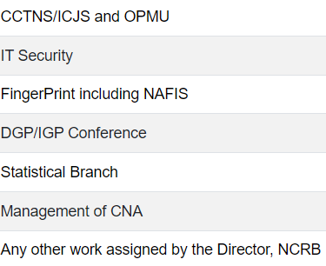
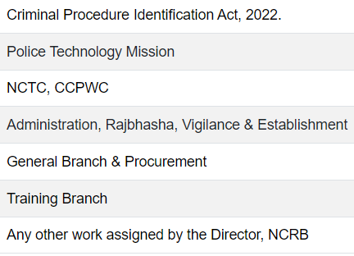
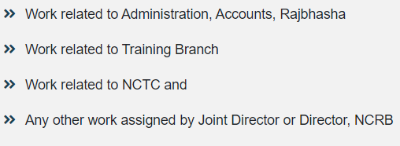
Director
Joint Director (CCNTS)
Joint Director
(Admin)
Dy. Director (CCNTS-II)
Link officer to DD(C-I) and DD(IT Security)
Deputy Director (IT Security)
Dy. Director (CCTNS-I & DCT)
Link officer to DD (C-II) and DD/Admin
Dy. Director
(Admin)
(Overall supervision of CCTNS Operational Project Management Unit (OPMU), PMG and NMG, Overall network related matters of CCTNS project)
(Overall supervision of Design, Development, Testing and Implementation of the Core Application Software (CAS) of CCTNS project And Improvement in CAS)
(Overall supervision of CFPB
NAFIS Procurement and Implementation)

Slide 11
Activities :
Central Citizen Services-
a) Missing Person Search-is a citizen service through which people can search at the convenience of their homes for their missing kin against the national database of recovered unidentified persons/ dead bodies. ,
b) Generate Vehicle NOC-This service allows citizens to ascertain the status of a vehicle before its purchase, as to whether it is involved in any crime or a stolen vehicle.
c) Proclaimed Offenders-On the direction of Hon’ble Supreme Court of India, a portal was created at national level for showing the details of Proclaimed Offenders to make the effective inter-state cooperation, efficient Law Enforcement and seek Citizen help.
d) Locate Nearest Police Station-GIS based mobile app that facilitates to locate, contact and navigate to nearest police station, in emergency situations. App is preloaded with authentic Longitude and Latitude of police stations as collected from all States/UTs police department.
B. National Cybercrime Reporting Portal (NCRP)- (DIGITAL POLICE)To manage technical and operational functions of the online cyber-crime reporting portal and associated work of Cyber Crime Prevention against Women & Children (CCPWC) scheme under the supervision and administrative control of Cyber & Information Security (CIS) Division of MHA. Launched on 30.08.2019 by MHA
C. National Cybercrime Training Centre (NCTC)- (CyTRAIN) for developing Massive Open Online courses (MOOC) platform to offer professional quality e-learning courses to all law enforcement agencies, prosecutors, judges and other stake holders.
D. Crime Multi-Agency Centre (Cri-MAC)- for flashing alerts/ Crime bulletins on important matters of crime and for inter-unit communication among disjointed police units across the country.
E. Automatic email alerts to Police Stations- A service of sending alerts through emails to the concerned Police Stations on automated matching of Missing Persons with Unidentified Found Persons (UIFP)/Dead Bodies (UIDB); and on automated matching of Stolen Vehicles with Seized/ Recovered Vehicles, based on national level databases under CCTNS project.

Slide 12
Crime and Criminal Tracking Network & Systems (CCTNS)
CCTNS is a Mission Mode Project under the National e-Governance Plan (NeGP) of Govt. of India. An allocation of Rs. 2000 crores has been made for CCTNS Project. Cabinet Committee on Economic Affairs (CCEA) has approved the project on 19.06.2009.
Objective- It aims at creating a comprehensive and integrated system for enhancing the efficiency and effectiveness of policing through adopting of principle of e-Governance and creation of a nationwide networking infrastructure for evolution of IT-enabled-state-of-the-art tracking system around 'Investigation of crime and detection of criminals’.
Background:
In past initiatives were taken place like NCRB-led CCIS (Crime and Criminals Information System) and CIPA (Common Integrated Police Application), and State-led initiatives such as e-COPS (in Andhra Pradesh), Police IT (in Karnataka), Thana Tracking System (in West Bengal), CAARUS (in Tamil Nadu) and HD IITS (in Gujarat).
NCRB started Crime and Criminals Information System (CCIS) in the year 1995, wherein State police headquarters and district headquarters were covered under this project.
NCRB started Common Integrated Police Application (CIPA) (2004-2009)
It was felt, however, that a standalone application couldn't provide the enhanced outcomes in the areas of Crime Investigation and Criminals Detection that are necessary. And for this reason, MHA has decided to launch the Crime and Criminal Tracking Network System (CCTNS) program. So, Crime and Criminal Tracking Network & Systems (CCTNS) is conceived in the light of experience of a non-plan scheme namely - Common Integrated Police Application (CIPA).

Slide 13
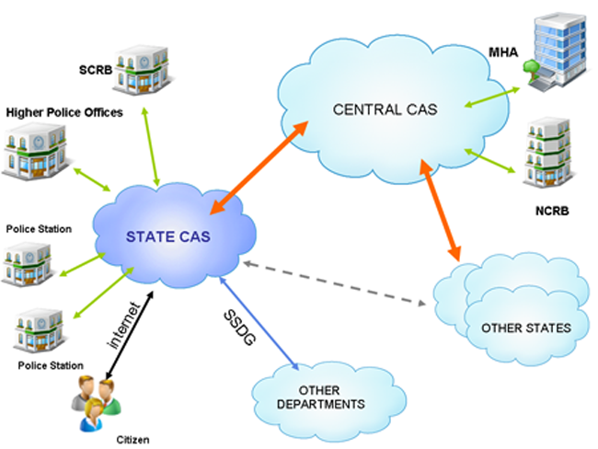
CAS- Core Application Software
SSDG- State e-governance Service Directory
SCRB- States criminal records Bureau

Slide 14
Objectives of CCNTS:
Make the Police functioning citizen friendly and more transparent by automating the functioning of Police Stations.
Improve delivery of citizen-centric services through effective usage of ICT.
Provide the Investigating Officers of the Civil Police with tools, technology and information to facilitate investigation of crime and detection of criminals.
Improve Police functioning in various other areas such as Law and Order, Traffic Management etc. Facilitate Interaction and sharing of Information among Police Stations, Districts, State/UT headquarters and other Police Agencies.
Assist senior Police Officers in better management of Police Force
Keep track of the progress of Cases, including in Courts
Reduce manual and redundant Records keeping
Under the CCTNS Project, as per CCEA note approx. 14,000 Police Stations throughout the country had been proposed to be automated beside 6000 higher offices in police hierarchy e.g. Circles, Sub-Divisions, Districts, Range, Zones, Police Headquarters, SCRBx including scientific and technical organizations having databases required for providing assistance and information for investigation and other purposes e.g. Finger Print Bureaux, Forensic Labs etc.

Slide 15
-Benefits to Police Department
Enhanced tools for investigation.
Centralized crime and criminal information repository along with the criminal images and fingerprints with advanced search capabilities.
Enhanced ability to analyze crime patterns and/ or modus operandi
Enhanced ability to analyze road incidents and other accidents.
Faster turnaround time for the analysis results (criminal and traffic) to reach the officers on the field.
Reduced workload for the police stations back-office activities such as preparation of regular and ad-hoc reports and station records management.
A collaborative knowledge-oriented environment where knowledge is shared across different regions and units.
Better coordination and communication with external stakeholders through implementation of electronic information exchange systems.
-Benefits to Ministry of Home Affairs (NCRB)
Standardized means of capturing the crime and criminal data across the police stations in the country.
Faster and easier access to crime and criminal information across the country in a manner amenable for trend and pattern analysis.
Enhanced ability to detect crime patterns through modus operandi across the States/UTs and communicate to the state police departments for aiding in crime prevention.
The ability to respond faster and with greater accuracy to inquiries from the parliament, citizens and citizens groups; and to RTI queries.
Easy and low-cost scalability of crime and criminal systems in the future.

Slide 16
-Benefits to Citizens
Multiple channels to access services from police.
Simplified process for registering petitions.
Simplified process for accessing general services such as requests for certificates, verifications, and permissions.
Simplified process and accurate means of tracking the progress of the case during trials.
Simplified and accurate access to view/report unclaimed/recovered vehicles and property.
Simplified process and channel for grievance registration.
Improved relationship management for victims and witnesses.
Faster and assured response from police to any emergency calls for assistance.
-Benefits to external departments
Seamless integration with police systems for better citizen service delivery and improved law enforcement.
Quick exchange of accurate information with the police department.
Simplified process for accessing general services such as requests for certificates, verifications, and permissions.
Simplified process and accurate means of tracking the progress of the case during trials.
Simplified and accurate access to view/report unclaimed/recovered vehicles and property.
Simplified process and channel for grievance registration.
Improved relationship management for victims and witnesses.
Faster and assured response from police to any emergency calls for assistance.

Slide 17
Bureau of Police Research And Development (BPR&D)
The Bureau of Police Research and Development (BPR&D), was established in 1970 under the Ministry of Home As The Government of India vied Resolution No.8/136/68-P.I (Pers.I) dated 28.08.1970.
The purpose of this new establishment was to give new orientation and modernisation to the already established Police Research and Advisory Council in 1966.
Primary responsibilities:-
To take direct and active interest in the issues
To promote a speedy and systematic study of the police problems,
To apply science and technology in the methods and techniques used by police.
Secondary responsibilities:-
The Resolution mandated an advisory role for the Bureau.
Modernization

Slide 18
EVOLUTION
The BPR&D was formed in 1970 and replaced the Police Research Advisory Council which was formed in 1966.
It was established with the aim to identify the needs and requirements of the police in the country, take up research projects and come up with suggestions to overcome the challenges faced by the police.
It comes under the administration of the Ministry of Home Affairs.
(To have a modern effective and sensitive security architecture that can inspire a sense of safety among all sections of society).
The Bureau was initially started with 2 divisions: 1) Research, Publication & Statistics Division & 2) Development Division.
In 1973 the Training Division was added on the recommendation of the Gore committee (1971) on police training.
In 1995 the correctional division was started to study the issues of prisons and prison reforms.
In 2008 the National Police mission (NPM) was added, and the Development Division was restructured as a modernisation division.
There are five divisions of the bureau headquarters and five central detective training institutes (CDTIs) at Kolkata, Hyderabad, Chandigarh, Ghaziabad, Jaipur, and the Central Academy of Police training at Bhopal.
In December 2022, the union home minister laid the foundation stone of the newest Central Detective Training Institute (CDTI) in Bengaluru. Two additional CDTIs are being considered for establishment—one in Srinagar and another in Agartala.

Slide 19
Bureau Of Police Research And Development (BPRD)
Separations:-
The Institute of Criminology and Forensic Science (ICFS) was established under the overall supervision and guidance of BPR&D later it was allowed to function as a separate entity in 1976.
Setting up the Institute was to develop a full-fledged academic institution for furthering studies in Criminology and forensic science. The same which was re-christened in the year 1991 is now functioning as Lok Nayak Jai Prakash Narayan (LNJN), National Institute of Criminology and Forensic Science from 1982.
The institute provides training courses for officers of the criminal justice system in the two subjects i.e. Criminology and Forensic Science and carries out research.
The Government of India, therefore, decided to establish a National Crime Records Bureau in 1986 build another Resolution and entrusted statistics and publications work of the Research Division to the newly constituted Bureau along with the plans for their computerization.
In an identical move brought about by compulsions of growth, the Government of India decided to give an independent status to the Forensic Science Division by creating a Forensic Science Directorate having an autonomous status under the direct control of the Ministry of Home Affairs.

Slide 20
Bureau Of Police Research And Development (BPRD)
Objectives
BPR&D analyses the general causes of crime, preventive measures and methods of improving the investigation, administrative structure and juvenile delinquency.
The mandate of BPR&D has provided meaningful space for all stakeholders in policing and correctional administration. The collective wisdom of the practitioners, the academia, and the civil society has culminated in inputs for policy imperatives in policing and prisons.
It assists in police research programs in the States. It also takes a regular assessment of equipment used by the police forces in India and ensures that new and modified pieces of equipment are provided in the fields of arms and ammunition.

Slide 21
Research Division(Res)
Analysis and study of general causes of crime; preventive measures; methods of improvising the investigation; administrative structure; Juvenile delinquency, etc.
The assistance of Police Research programmes in States and participation in social defense and crime prevention programmes
Development Division/Modernization division (Mod)
Take a regular assessment of the equipment used by the police forces in India and ensure that new and modified pieces of equipment are provided in the fields of Arms and Ammunition, Riot Control Equipment, Traffic Control Equipment, Police Transport and other scientific aids for investigation. Providing access to computer technology in various fields of the police force
Administrative Division (Adm)
Managing the matters related to the police workforce, their units and headquarters
Maintaining all accounts and budgets and Working for the welfare of the staff of BPR&D
Training Division (train.)
Evaluate the training programmes conducted for the police force
Assess that the training is suitable as per the social state of the country and the force is well prepared for every circumstance
To liaise with the Directorate of Training of the Department of Personnel in relation inter-alia to training aids projects and fellowships under the UNDP, UNESCO & Colombo Plan etc.
To create and maintain a circulating library of films for the use of various police training institutions
Supervising the three central detective training schools, situated at Chandigarh, Kolkata and Hyderabad
Correctional Administration (CA)
Analysis and study of prison statistics and problems of a general nature affecting Prison Administration. and Assimilation and dissemination of relevant information to the States in the field of Correctional Administration.
Review training programs keeping in, view the changing social conditions, the introduction of new scientific techniques, and other related aspects.
National Police mission NPM DIVISION
It co-ordinates and translate the Action Plans into projects.
The mission will pay special attention to empowering the police force at all levels; to appropriate decentralization and delegation of powers; to enhancing the skills and competency levels.

Slide 22
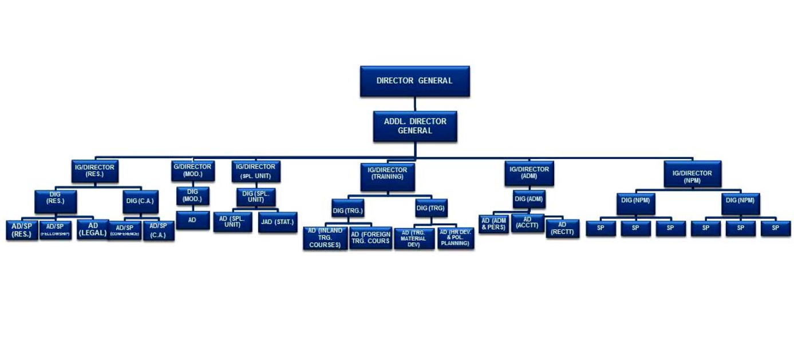
ORGANISATIONAL SET UP

Slide 23


Slide 26
RESEARCH DIVISION (Res.)
Analysis and study of crime and problems of general nature affecting the police
Trends and causes of crime,
Prevention of crime - preventive measures, their effectiveness and relationship with crime.
Organization, strength, administration, methods; procedures and techniques of the police forces and their modernisation; Police Act and manuals
Improvements in methods of investigation, utility and results of introducing scientific aids and punishment;
Inadequacy of laws,
Juvenile delinquency;
Police Uniform, badges, medals, decorations, colours and flags, police drill, warrant of procedure etc
2. Assistance of Police Research programmes in States, processing and coordination of research projects; sponsoring extra-mural research.
3. Work relating to Standing Committee on Police Research.
4. Police Science Congress & other conferences and seminars relating to study of police problems.
5. Participation in social defence and crime prevention programmes.
6. Participation in the work of the United Nations in the field of prevention of Crime and treatment of offenders.

Slide 27
CORRECTIONAL ADMINISTRATION (C.A.)
Analysis and study of prison statistics and problems of a general nature affecting Prison Administration.
2. Assimilation and dissemination of relevant information to the States in the field of Correctional Administration.
3. Coordination of Research Studies conducted by RICAs and other Academic/Research Institutes in Correctional Administration and to frame guidelines for conduct of research studies/surveys in consultation with State Governments.
4. To review training programs keeping in, view the changing social conditions, the introduction of new scientific techniques, and other related aspects.
5. To prepare a uniform Training Module including course, syllabi, . curriculum, etc. For providing training at various levels to the Prison staff in the field of Correctional Administration.
6. Publication of reports, newsletters, bulletins, and preparation of audio-visual aids, etc. in the field of Correctional Administration.
7. To set up an Advisory Committee to guide the work relating to Correctional Administration.

Slide 28
Development Division (Dev.)
Review of the performance of various types of equipment used by the police forces in India and development of new equipment in the following fields:
Arms and Ammunition;
Riot Control Equipment;
Traffic Control Equipment;
Police Transport and
Miscellaneous scientific equipment and scientific aids to investigation.
2. Liaison with the National laboratories, various scientific organisations and institutions and public and private sector undertakings in the above fields; coordination of development programmes and stimulating indigenous production of police equipment.
3. Application of computer technology in various fields of police work.

Slide 29
TRAINING DIVISION
To review from time to time the arrangements for Police training and the needs of the country
2. To supervise the working of three central detective training schools, situated at Chandigarh, Kolkata and Hyderabad.
3. To evaluate training programmes with a view to securing such standardization and uniformity in the training arrangements including courses, syllabi and curricula
4. To help devise new refresher, promotion, specialist and orientation courses considered necessary for the different grades and kinds of police officers.
5. To prepare, in coordination with the police training institutions, standard manuals, textbooks, pamphlets, lecture notes, case studies, practical exercises and other educative literature for use in these institutions.
6. To distribute relevant literature to inspectors General/DIsG (Training) in the States for circulation to officers in order to familiarise them with training concepts and to strengthen training consciousness among the higher ranks.
7. To standardize equipment for training and training aids and to arrange for their production and supply to the various training institutions.
8. To create and maintain a circulating library of films for the use of various police training institutions.
9. To assist in the training of police officers of various ranks at appropriate nonpolice institutions inside and outside the country.

Slide 30
Administration Division
All personnel matters of Officers and staff in the HQrs and outlying units
2. All financial powers/matters being exercised by the Head of the Department are processed in admin division
3. All accounts/budgets related matters
4. Administrative matters of the Central Detective Training Schools, Chandigarh, Kolkata and Hyderabad
5. Procurement of equipment and financial sanctions of all the Divisions of BPR&D and outlying units, which are sanctioned under the powers of the Head of Department
6. Welfare of the staff of BPR&D HQrs/outlying units
7. House keeping of the premises
8. Coordination between all the Divisions of BPR&D.

Slide 31
National Police mission NPM DIVISION
It co-ordinates and translate the Action Plans into projects.
The mission will pay special attention to empowering the police force at all levels; to appropriate decentralization and delegation of powers; to enhancing the skills and competency levels.
The mission will seek to transform the police forces in the country into effective instruments for maintenance of internal security and facing the challenges of the next century, by equipping them with the necessary material, intellectual and organizational resources.
“Police” and “Law & Order” being State subjects, as per the Constitution of India, the needed police reforms and transformations have to be undertaken primarily by the State and U.T. Governments. As such, the NPM will strive, in consultation with the State Governments, to bring about the desired results.
The Mission shall lay down road map for bringing in sensitivity among police personnel towards concerns of vulnerable and weaker sections of the society.
The Mission shall promote networking of police organizations with educational and industrial forums for taking up studies for bettering the policing methodology.
The NPM shall endeavor to ensure uniformity in police rules and regulations, as far as possible, in the different State and Union Territories, which is necessitated by growing movement of men and material from State to State.
The Mission shall focus both on the special requirements of the mega/metropolitan policing, and systems to strengthen policing in rural areas.
The NPM shall also effectively utilize fora that have been set up to standardize police training in the States, and to establish specialized police training centers as Centers of Excellence.

Slide 32
PRESESNT
The data collected in 2021 and published in 2022 pointed out that the total sanctioned police force in the country stood at 26,88,938. While the total actual police force stood at 20,93,833.
The strength of women in the police force is 11.75%. The percentage increase of women in the police force over the previous year was 13.40%.
The total sanctioned strength of central armed parliamentary forces was 11,10,804 while the actual total strength was 10,21,501.
The strength of women police in the Central Armed Police Force (CAPF) was 3.98%.
National Initiatives:
The Kavach 2023 is scheduled to be held in August and was launched in February earlier this year.
national-level hackathon to address cyber security challenges and cybercrimes in the country.
a Cyber Crime Prevention against Women and Children (CCPWC) scheme - Comprises an online cybercrime reporting portal for cases of Child Pornography/ Child Sexual Abuse Material, rape/gang rape imageries or sexually explicit content.
Global Initiatives :
In 2023, two conferences were organised in collaboration with the Ministry of External Affairs for the Conference on Interaction and Confidence Building Measures in Asia (CICA) member states ( an intergovernmental forum aimed at strengthening regional cooperation and ensuring peace, security, and stability in Asia)
A strategic partnership between the Bureau of Counterterrorism (CT) and the Bureau of Diplomatic Security (DS), the Anti-Terrorism Assistance (ATA) Program serves as a primary provider of US government antiterrorism training and equipment to the partner nations, building capacity to investigate, detect, deter, and disrupt terrorist activities while bolstering foreign civilian law enforcement counterterrorism skills. India has been associated with this program since 1995.

Slide 33
Challenges of BPRD:
Limited Resources
Diverse and Dynamic Policing Landscape
Bridging the Research-policy Gap
Technological Advancements
The Future Needs Of BPRD:
Increased Funding
Funding will facilitate the hiring of skilled researchers, upgrading infrastructure, and conducting comprehensive studies on emerging policing challenges.
Collaboration and Partnerships
Capacity Building and Training
Address the evolving challenges in policing, including technology, community engagement, and crime prevention.

Slide 34
Central detective training schools (CDTIs)
The idea of setting up CDTS was initially conceived by the late illustrious police officer, Shri B.N. Mallick, the then Director, Intelligence Bureau.
The late Home Minister Pt. Govind Ballav Pant encouraged the idea and the School was first incepted in 1956. The Institute was later brought under the aegis of BPR&D.
There are five CDTIs in India located at Chandigarh, Hyderabad, Kolkata Jaipur, and Ghaziabad functioning under the Bureau of Police Research & Development, Ministry of Home Affairs.
There are several courses run by the institution like Advanced Course on Investigation & Detection of Crimes (10 weeks) for the police personnel of the ranks of Sub Inspectors and Inspectors having a minimum of 5 years experience in their respective fields.
In these courses the police personnel are trained on various aspects of Scientific Aids to Investigation as well as Law and Procedure and professional knowledge. The syllabus of the course is chalked out by BRP&D and is upgraded regularly to make it more relevant and topical.
Each CDTS is headed by a Principal, who is an IPS Officer. The Principal is assisted by one Vice Principal and other faculty members of the rank of Dy. SPs & Inspectors in imparting training to the participants.

Slide 35
Besides the in-house faculty members, experienced senior police officers, belonging to the rank of D.G., I.G., D.I.G. and SP, eminent judges, doctors, academicians, forensic experts, professors etc. are invited by the CDTS to deliver lectures and their expert opinion on different topics of their respective fields.
Forensic subjects include practical training of footprint, fingerprint, handling, labeling and packing etc. The trainee officers get an opportunity to have practical and theoretical knowledge on ballistics, physical and chemical analysis of biological matters like blood, semen, hair, fibre, dust, other objects of forensic importance, different types of forged documents and counterfeiting notes, documents etc. from GEQD and CFSL.
They can equip them selves with the latest know-how of the sophisticated methods of scientific analytical techniques like the DNA fingerprinting and other modern techniques of investigation.

Slide 36
Principal IPS rank
Vice Principal
Faculties
Dy,S.P
Number varies as per the load
Cyber
Number varies as per the load
Inspector
Number varies as per the load

Slide 37
National Police Academy(NPA)
VISION:
We aspire to be a Global Center of Excellence and the Nodal Center of Police Training in India - setting Benchmarking Standards, leading the Network of Police Training Institutions in the country and contributing to their Capacity Building, developing training literature, besides being a Centre for Research par excellence on Policing and Internal Security issues, ever keeping pace with emerging challenges.
We shall build a cadre of exemplary police officers who will uphold the Rule of Law, respect National values of Secularism, Democracy, Equality and Service to People and ensure the dignity and Human Rights of the citizens with sensitivity.
MISSION:
The Primary purpose of the Academy is to prepare leaders for the Indian Police, who will lead/command the force with courage, uprightness, dedication and a strong sense of service to the people.
EVOLUTION:
After Independence, Sardar Vallabhbhai Patel, the first Union Home Minister emphasized the importance of having a ring of services which would keep the country intact under a Federal Constitution. He said, “...the Union will go, you will not have a united India, if you do not have a good All India Service, which has the independence to speak out its mind...”. Thus was born the Indian Police Service (IPS) as an All India Service, as successor service to the IP.
With a view to imparting induction training to the new entrants to the IPS who were drawn from all regions of the country and different strata of society, the Central Police Training College was established in Mount Abu (Rajasthan) on September 15, 1948.

Slide 38
This institution was renamed as National Police Academy in 1967. As a befitting token to the memory of Sardar Vallabhbhai Patel, the Iron Man of India, who had the foresight and dynamism to think in terms of all-India level Police Service, the Academy was named after him in 1974 as Sardar Vallabhbhai Patel National Police Academy.

Slide 39
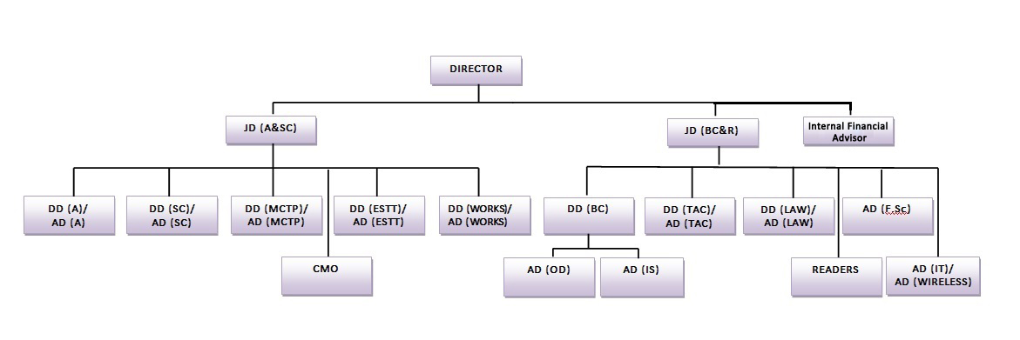
Organisation:
The Academy is headed by a Director, an IPS Officer of the rank of Director General of Police and assisted by 2 Joint Directors of the rank of Inspector General of Police, 6 Deputy Directors of the rank of DIG of Police and Assistant Directors with sanctioned strength of 20, which includes police officers of the rank of Superintendent of Police from state cadres, a Forensic Scientist, a Specialist each in Computers and Wireless. The sanctioned strength of the faculty also includes a Scientist, a Reader in Behavioural Sciences, a Reader in Teaching Methodology, 1 Staff Surgeon, 3 Medical Officers, a veterinary officer, 3 Addl. SP, 7 Dy. SP/AC, 2 Senior Scientific Officer, a Hindi Instructor, a Photographic Officer and a Chief Drill Instructor. The supporting staff includes administrative, ministerial and medical staff and other Group C employees. The total sanctioned staff strength of the Academy is 692.

Slide 40
FUNCTIONS:
The National Police Academy (NPA), trains officers of the Indian Police Service, who have been selected through an All India based Civil Services Examination.
The trained officers will be posted as Assistant Superintendent of Police (ASP) in their respective states under whom the other sub-ranks of police force will be working.
The recruitment of sub-ranks such as Constables, Sub-Inspectors, Deputy Superintendents of Police is each states prerogative, and will be done by respective state Director Generals of Police.
The IPS cadre is controlled by the Home Ministry of the Government of India and the officer of this service can only be appointed removed by an order of the President of India.
Apart from the Basic Training Course for IPS officers the Academy also conducts Compulsory Mid Career Training Programme for officers of SP., DIG. and IG/Addl DG levels of the Indian Police Service; Training of Trainers' Courses for the trainers of various police training institutions in the country; IPS Induction Training Course for State Police Service Officers; and short specialised thematic Courses, Seminars and Workshops on professional subjects for all levels of police officers.
Foreign police officers and other officers belonging to Army/IAS/IFS/Judiciary, Public Sector Undertakings, Nationalised Banks, Insurance Companies etc. also attend various specialised courses conducted here from time to time. The Academy is affiliated to Osmania University for conducting courses on police subjects for IPS officers.

Slide 41
Directorate of Forensic Science services (DFSS)
The Directorate of Forensic Science services (DFSS) was created in the year 2002 by Ministry of Home Affairs, Govt. of India, after bifurcation from BPR&D, based on the recommendations of National Human Rights Commission and Padmanabhaiah Committee on Police Reforms.
The Gazette notification to this effect was issued by MHA vide its Order no. 25011/41/2001-GPA.II/PM-II on December 31, 2002. It is headed by Director-cum-Chief Forensic Scientist. It has six Central Forensic Science Laboratories under its control located at Chandigarh, Kolkata, Hyderabad, Pune, Guwahati and Bhopal.
Mission Statement of DFSS:
The Mission statement of the Directorate of Forensic Science Services is to render 'High quality and credible forensic services' to justice delivery system.

Slide 42
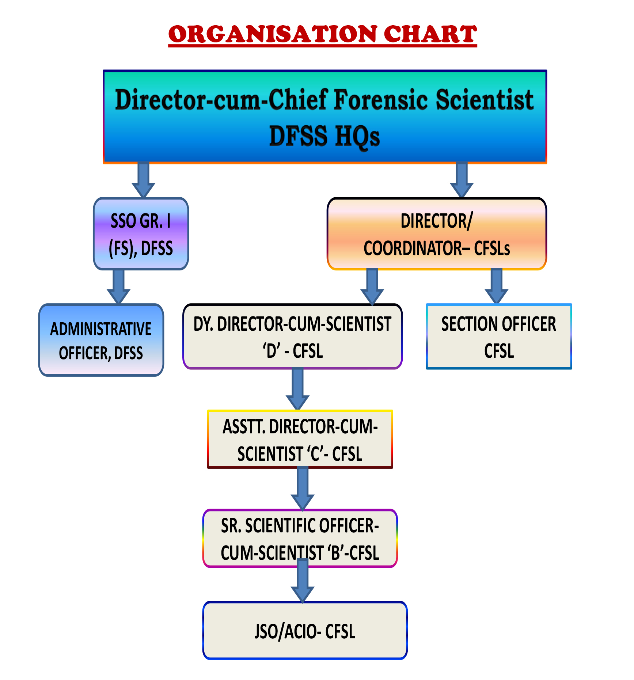

Slide 43
GOI- Government of India
MHA- Ministry of Home Affairs
Directorate of Forensic Science services DFSS
Central Bureau of Investigation CBI
6 Central Forensic Science Laboratories CFSLs,
Pune, Guwahati, Kolkata, Chandigarh, Bhopal, Hydrabaad
1 CFSLs Delhi
32, State Forensic Science Laboratories SFSLs
106, Regional Forensic Science Laboratories RFSLs
552, Mobile Forensic Science Laboratories MFSLs

Slide 44
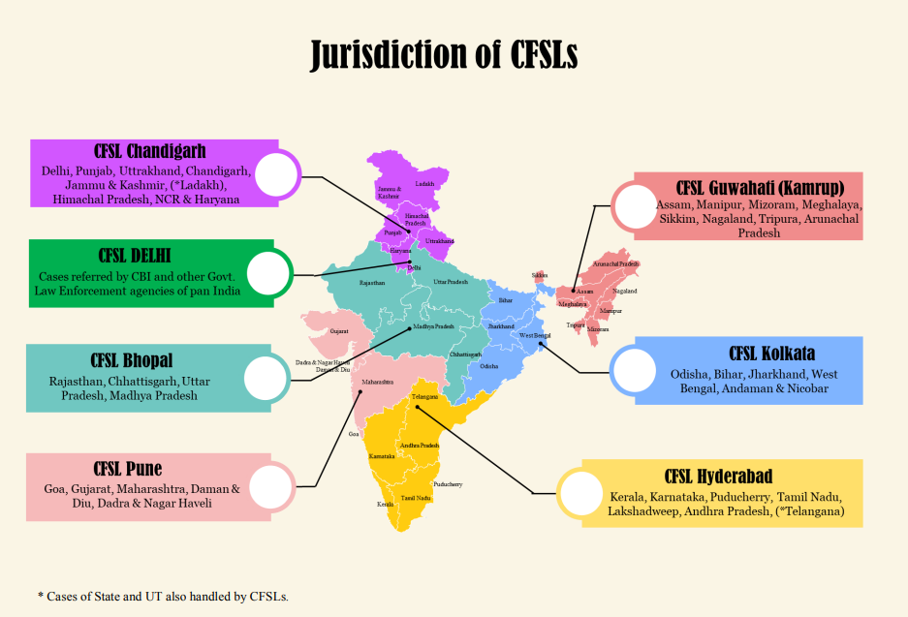

Slide 45
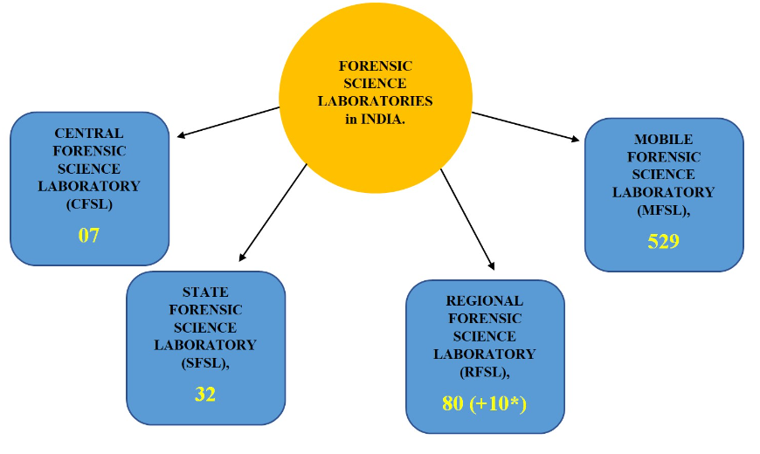

Slide 46
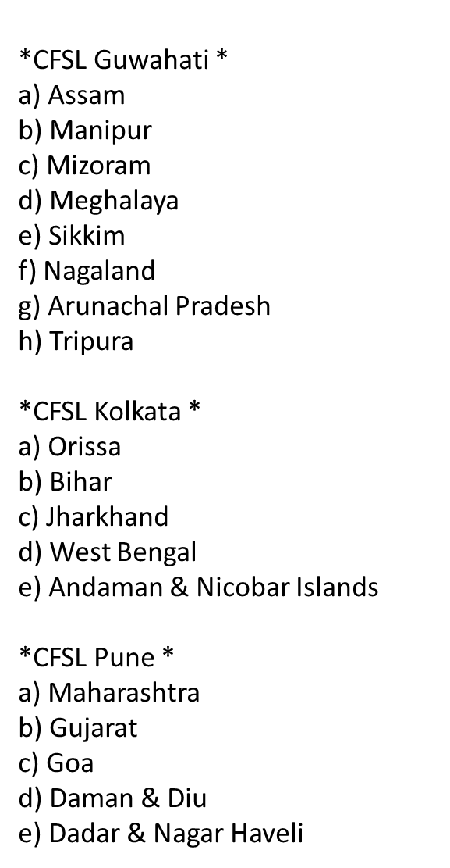
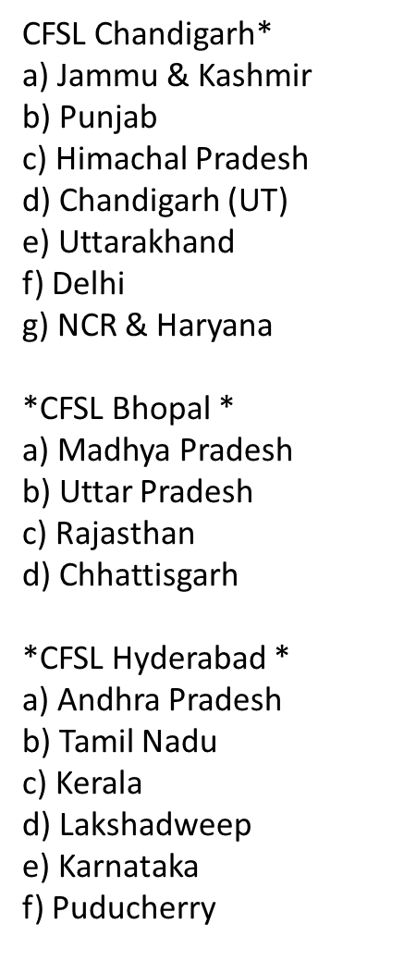
Jurisdictions of CFSLs

Slide 47
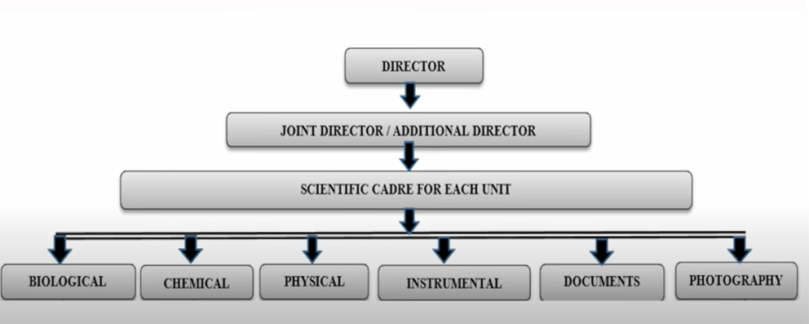

Slide 48
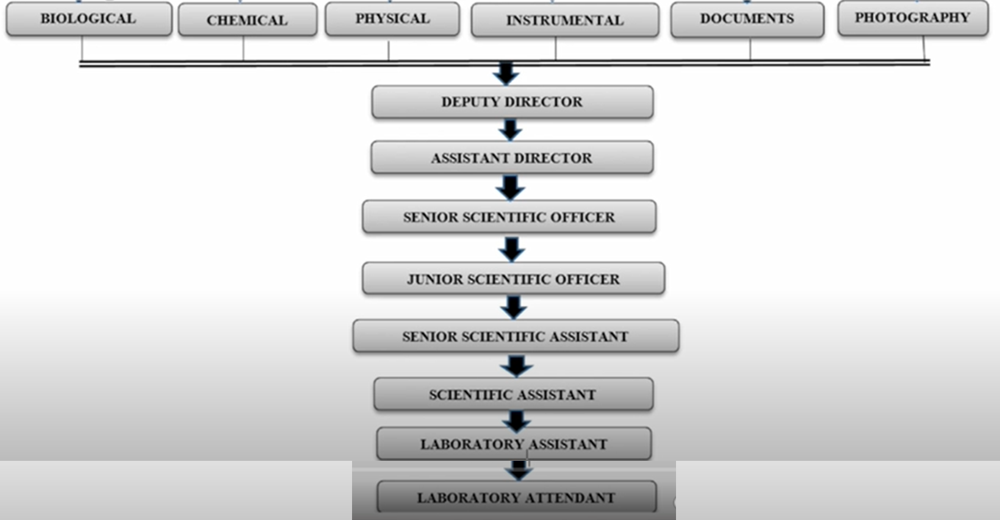

Slide 49
The Directorate of Forensic Science Services is responsible for performing following duties:
To provide high-quality and on-time Forensic Services to Criminal Justice Delivery System.
2) To develop new technologies and create new scientific knowledge.
3) To encourage Research & Development in various areas of forensic science
4) To establish linkages with National and International Scientific, Forensic Institutions and
Universities.
5) To promote Quality Assurance and Quality Control in Forensic Testing.
6) To disseminate and promote knowledge in the field of application of Science and technology.
7) To formulate Plans and Policies to promote capacity building in Forensic Science in the
Country.
8) To develop a National database on various forensic indices.
9) To promote excellence in Forensic Services & R&D by instituting awards & incentive programs.
10)To assist and advise the Central and State Governments in all Forensic Science matters.

Slide 50
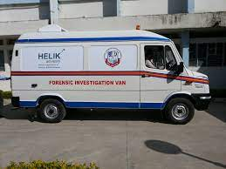
MOBILE CRIME LABORATORIES

Slide 51


Slide 52
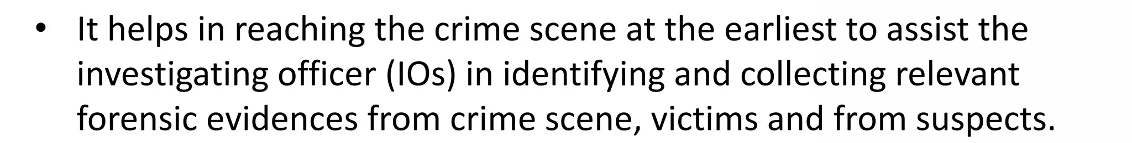
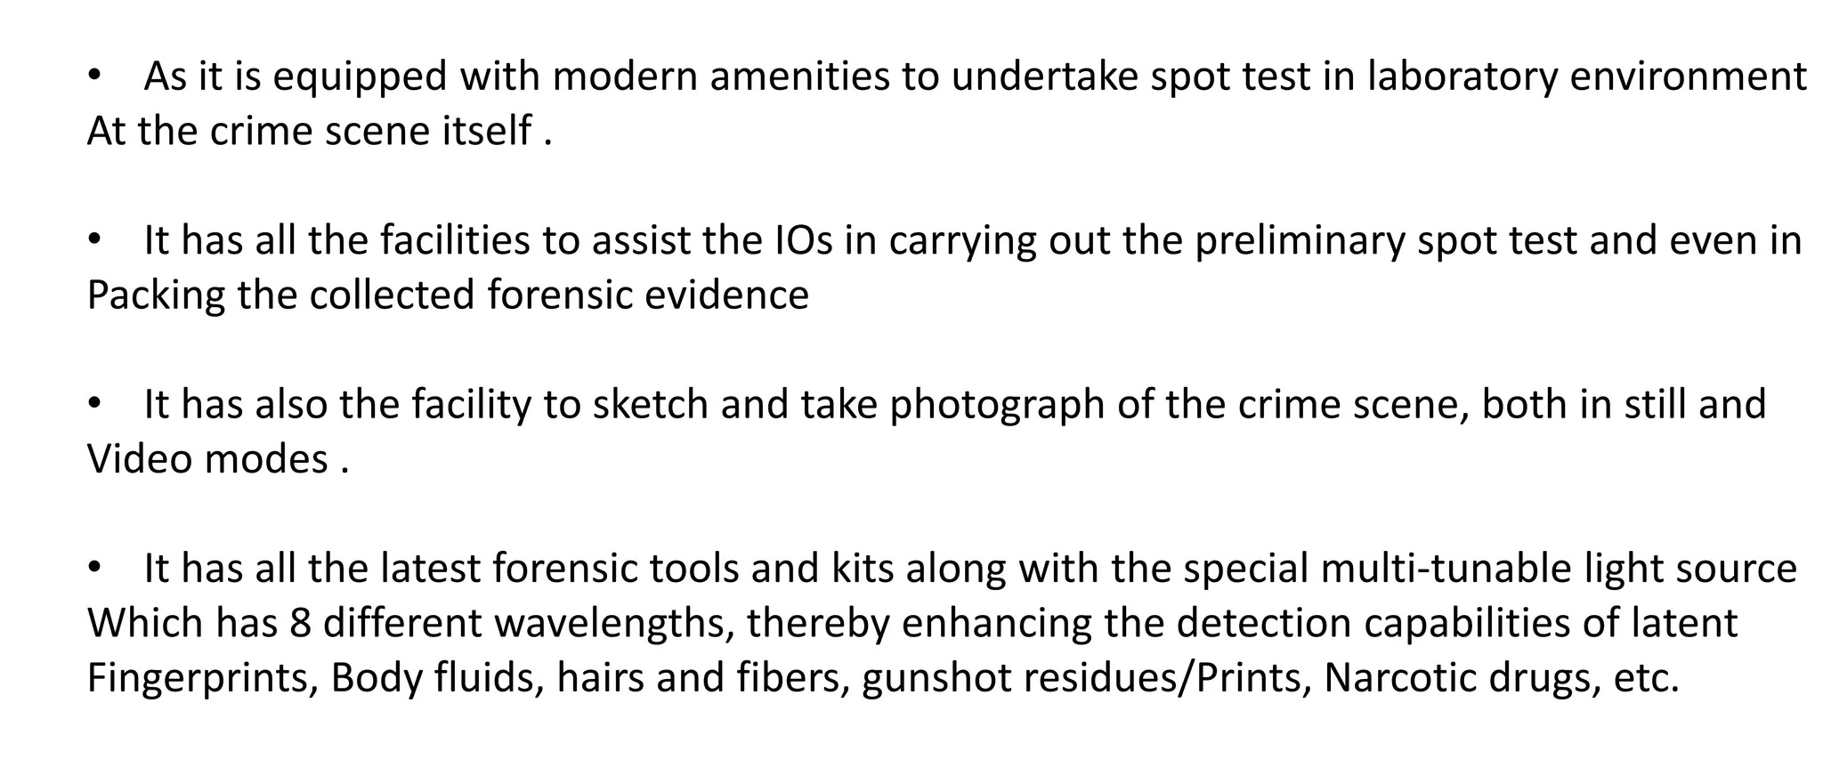

Slide 53
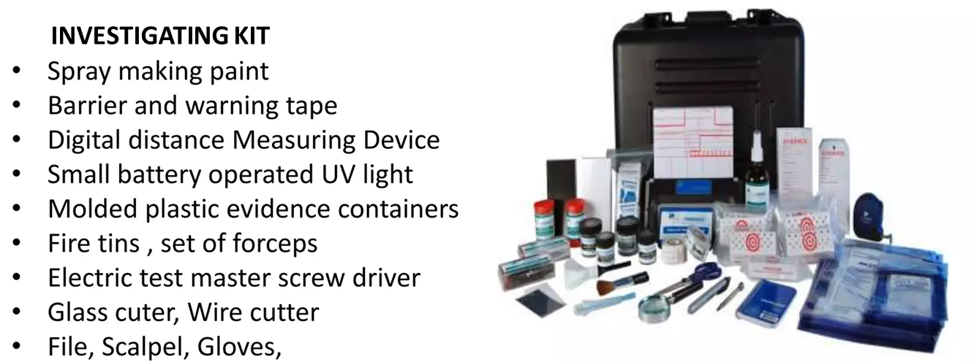
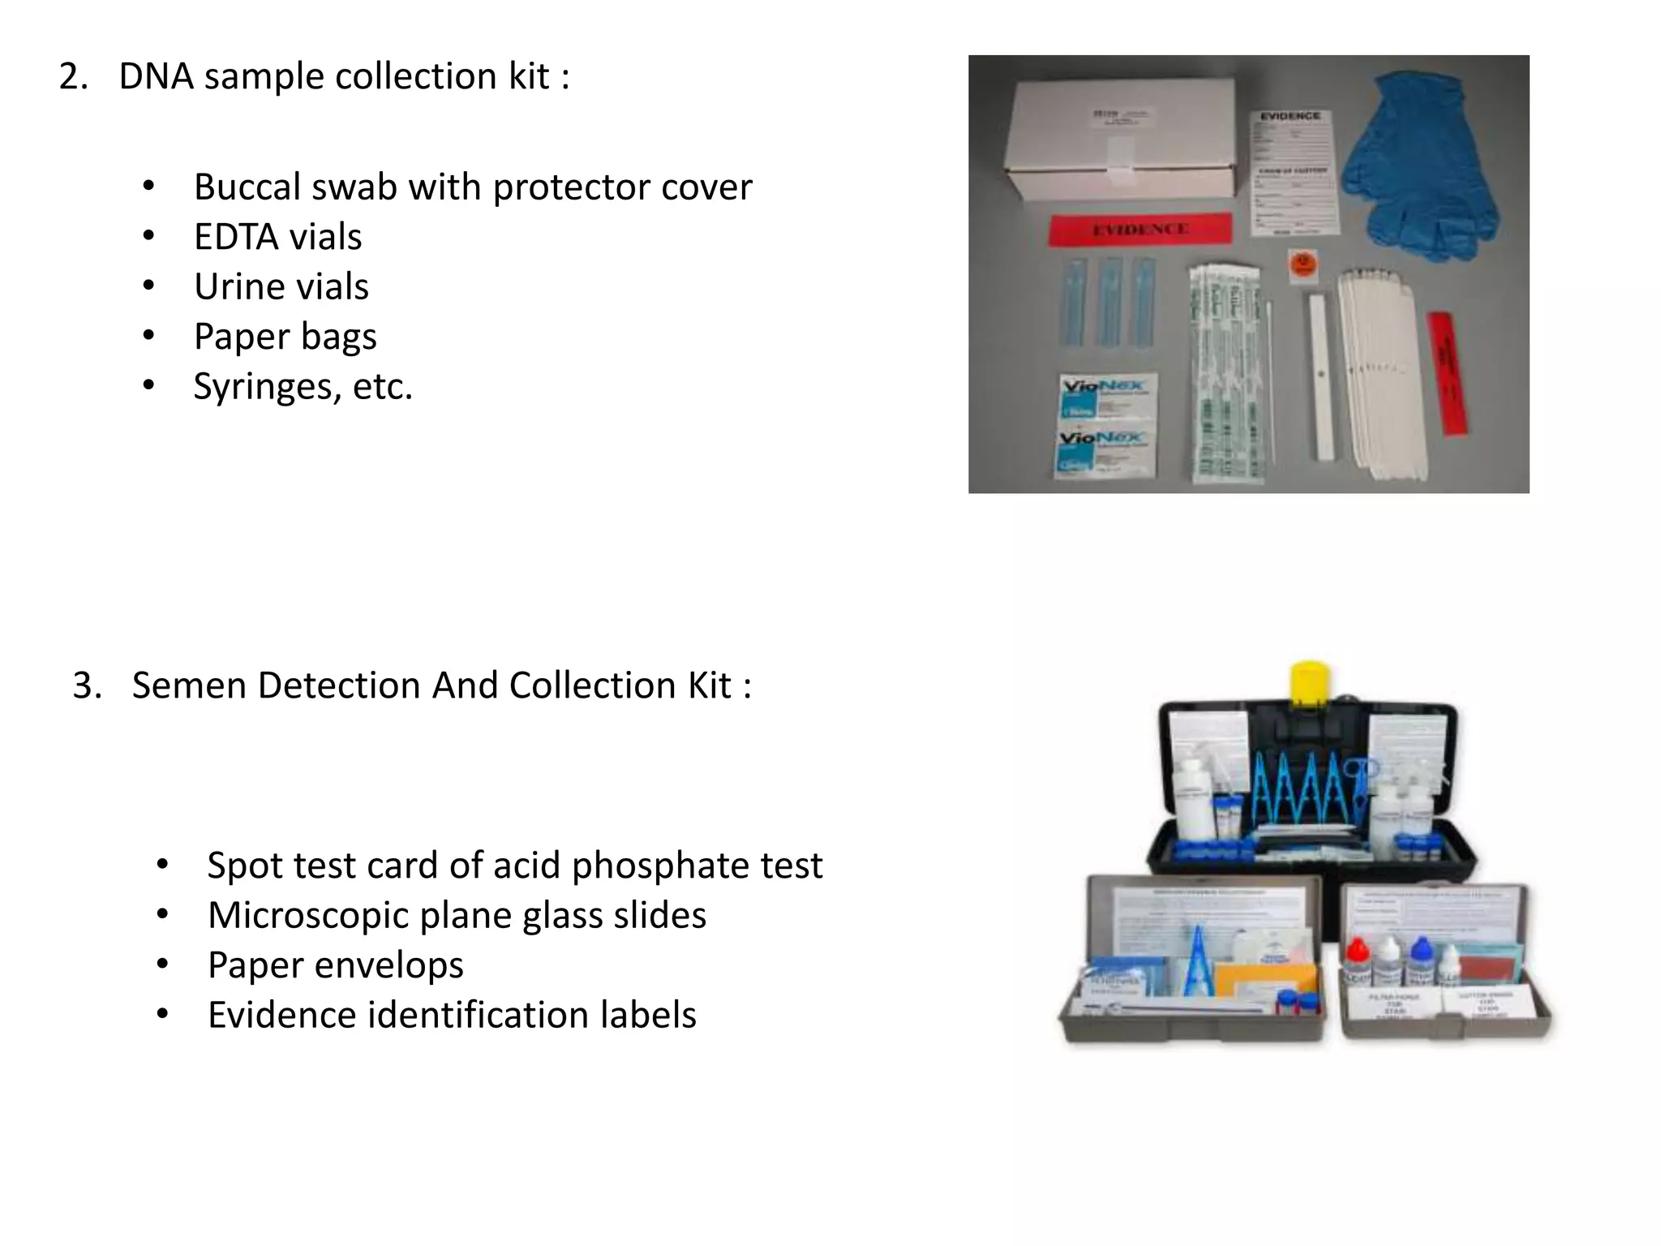
They Carry:

Slide 54
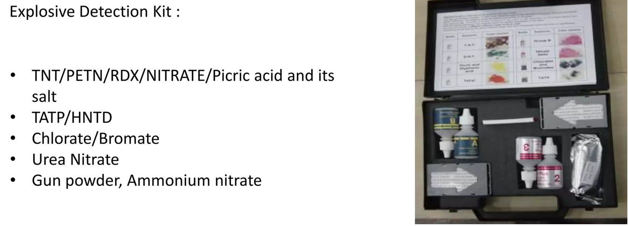



Slide 55
Central Finger Print Bureau (CFPB)
Finger prints play very important and crucial role in criminal justice system since ancient time.
Finger prints are the impressions of friction ridges that are present on the palmer surface of finger tips. These friction ridges have a specific detail on the gripping surfaces with an enhanced quantity of nerves and pores, these tiny raised peaks and valleys are located on the tips of the fingers along with sweat pores.
Human fingerprints are, nearly unique, they are difficult to alter, and cannot change over the life of an individual except in case of deep injury and amputation, this quality makes them suitable as long-term markers of human identity.
According to Victor Balthazard evaluation, the probability of finding same finger print of two person is 10⁶⁰ across the globe.
The first finger print bureau of world was officially declared open at Calcutta in July 1897 by efforts of the police chief of south Bengal, Sir Edward Richard Henry.
Henry approached the Government to pursue approval for replacing the anthropometric data by fingerprints for the identification of habitual criminals. His idea was taken up by Sir Francis Galton, who then established scientifically the basic principles of uniqueness and permanency of finger prints.
(Thus the bureau officially established as a first finger print bureau of the world at Calcutta in July 1897).

Slide 56
After that another Central Finger Print Bureau (CFPB) was established at Shimla in 1905, although it was closed in 1922.
The present Central Finger Print Bureau came into existence in 1955 under the administrative control of Intelligence Bureau at Delhi. and was relocated to Calcutta (now Kolkata) in 1956.
The administrative control of Central Finger Print Bureau shifted to Central Bureau of Investigation (CBI) in 1973, and since July, 1986, this has been under the administrative control of national Crime Record Bureau (NCRB).
Now a days each state forensic science laboratory have their own fingerprint sections of individual finger print bureau.
When finger prints are used for criminal investigation for two types of identifications-
1) Personal identification- Personal identification involves establishing the true identity of a person who are already in custody.
2) chance Print identification or latent finger print identification – this is found at crime scene.
In forensic science or criminal investigation system the most crucial work of finger print bureau is to link the finger impressions identified and lifted from the scene of crime to the criminal who committed the crime.

Slide 57
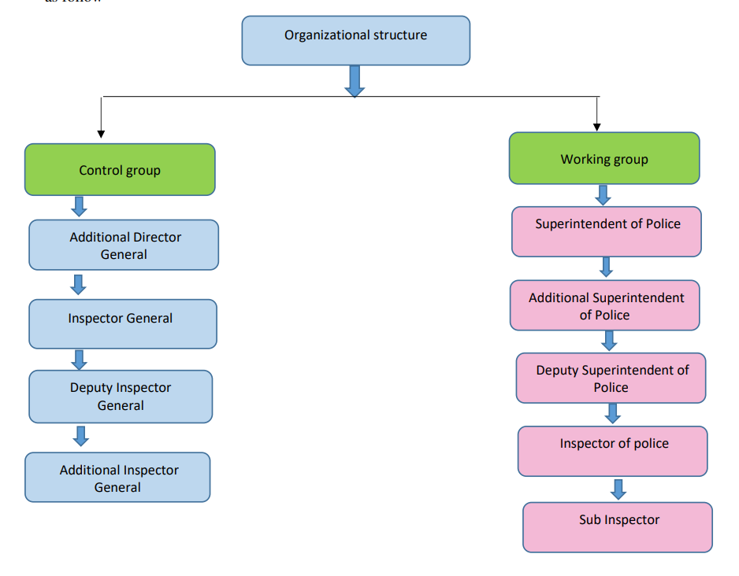

Slide 58
Objectives of Finger Print Bureaus
To maintain Finger Print record slips of the accused person convicted in various acts.
To conduct search relating to unidentified interstate arrested/suspected persons received from police stations and other investigating agencies in India.
To maintain the fingerprints of international criminals and red corner notices sent by Interpol and to conduct search on references received from foreign countries, through Interpol.
To undertake examination of questioned finger impressions on documents received from central government departments, undertakings, courts of law etc.
To impart training in Fingerprint Science to State or Central Police personnel and also to personnel from foreign countries under ‘Technical Co- Operation Scheme’ (TCS) of Colombo Plan, 'Special Commonwealth African Assistance Plan' (SCAAP) and `International Technical and Economic Co-Operation' (ITEC).
To co-ordinate the work of the State Finger Print Bureaux and give necessary guidance in all matters relating to Fingerprint Science.
To conduct the All India Conference of Directors of Finger Print Bureaux.
To conduct All India Board Examination annually for accrediting Finger Print Experts.
To conduct competition in Finger Print science at the All India Police Duty Meet held annually.

Slide 59
Functions of Central Finger Print Bureau
To maintain Finger Print Record Slips, conduct search of specified categories of Indian and foreign criminals convicted of offences.
To maintain records of international criminals sent by the International Police Organization (Interpol) Division of Central Bureau of Investigation and Narcotics Control Bureau, New Delhi.
To undertake examination of questioned finger impressions referred by Central government departments and government of India undertakings.
To impart training in fingerprint Science (Theory and Practical) to police and non-police personnel of state government in India and personnel from foreign countries
To Co-ordinate the work of the State Finger Print Bureaux and give necessary guidance.

Slide 60
Functions of State Finger Print Bureau:
The main functions of this Bureau are:
Record Wing:
Recording of Finger Print Slips of convicted persons in the state.
Maintenance and updating of Fingerprint & conviction details of convicted persons.
Search Wing:
1) Search of Finger Print Slips to collect previous history of arrested persons. Whenever a person is arrested, his finger print slip will be taken and forwarded to the bureau. On searching the same among the records we can find out whether he/she is an ex-convict, his actual name and address, how many convictions have been recorded in his name, whether he is wanted in any cases, and in which cases he had been traced for etc.
2) Identification of un-identified dead bodies: - Whenever an un-identified dead body is found, its finger prints are taken and forwarded to the bureau.
Document Wing:
Giving Expert Opinion in Civil & Criminal cases regarding Fingerprint Disputes.
AFIS (Automated Finger Print Identification System):
Bureau is maintaining a database of criminals which is frequently updated. The system has helped the identification of several unsolved cases which include the detection of other state cases.
Advanced Research Laboratory:
Many state finger print bureau developed advanced research laboratory which will enhance original contributions in the field of Dactyloscopy.
Training:
Finger Print Bureau is imparting training to professional of various branches.

Slide 61
GEQD
Government Examiner of Questioned Documents (GEQD) was established for the first time at Calcutta by British Government of Bengal in the year 1904. later moved to Shimla in 1906. Second GEQD was established in Kolkata in 1966 and third was established at Hyderabad in 1968.
There are three GEQDs namely- GEQD Shimla, GEQD Kolkata and GEQD Hyderabad.
At present, these three, GEQD Shimla, GEQD Kolkata and GEQD Hyderabad has been merged with CFSL, Chandigarh, Kolkata and Hyderabad respectively.
The main aim behind opening of GEQD was to examine the documents related to Indian Independence Movement.
It was established by britishers to identify handwritings on secret documents connected to the freedom fighters associated with the Indian National Movement.
After Metropolitan Police Laboratory, UK, which was established in the year 1902, it is world’s second oldest forensic science laboratory in the world.
C.R. Hardless was appointed as the first GEQD. Then, he was replaced by F. Brewster, a Police Officer from West Bengal CID and afterwards Mr. S.N. Sen was the first Indian to took over this place in 1949.

Slide 62
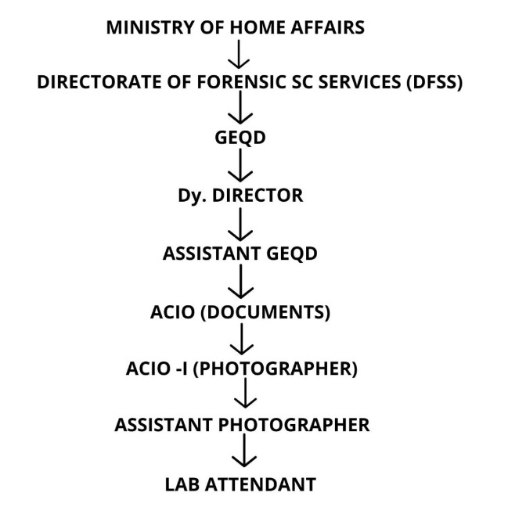
Oraganisation setup of GEQD

Slide 63
Objectives of GEQD
Analysis of handwriting on secret documents
Comparison of signatures
Handwriting comparison
Ransom notes examination
Suicide notes analysis
Personal diary and other writings

Slide 64
Other National level Agencies
Intelligence Bureau (IB) is India’s intelligence agency which gathers intelligence from within the country and also executes counter-intelligence and counter-terrorism tasks.
It functions under the aegis of the Ministry of Home Affairs. It is headquartered in New Delhi.
History of IB
Intelligence Bureau was founded in 1887 as Central Special Branch by the British Indian government.
It is reputed to be the oldest such organization in the world.
In 1909, the Indian Political Intelligence Office was established in England in response to the development of Indian revolutionary activities.
By 1921, it came to be called Indian Political Intelligence (IPI) constituting a surveillance and monitoring agency. It was run jointly by the India Office and the Government of India and maintained close contact with Scotland Yard and MI5.
After Indian independence in 1947, IPI was renamed as the Intelligence Bureau under the Ministry of Home Affairs.
Until 1968, it handled both domestic and foreign intelligence after which Research and Analysis Wing (RAW) was formed specifically for foreign intelligence. The establishment of RAW led to IB being primarily assigned the role of domestic intelligence and internal security.

Slide 65
The IB draws its employees from law enforcement agencies such as the Indian Police Service (IPS), the Indian Revenue Service (IRS), and the military.
The IB director is part of the Strategic Policy Group and the Joint Intelligence Committee (JIC) of the National Security Council, and reports directly to the Prime Minister.
Functions of IB
IB is used to garner intelligence from within India and also execute counter-intelligence and counter-terrorism tasks.
In addition to domestic intelligence responsibilities, the IB is particularly tasked with intelligence collection in border areas.
All spheres of human activity within India and in the neighbourhood are allocated to the charter of duties of the Intelligence Bureau.
Most of the activities of the IB are classified hence less information is available about its functioning and missions.

Slide 66
Other National level Agencies
The Research and Analysis Wing (RAW) is the external intelligence agency of India, established in September 21, 1968.
Until 1968, the Intelligence Bureau was made responsible for internal and external intelligence activities. The Indo-China war of 1962 and the Indo-Pakistan war of 1965 has shown gaps in the intelligence gathered by the IB. The IB failed to estimate the military preparation of China and Pakistan in the wars of 1962 and 1965. Against this backdrop, the then Indira Gandhi government felt the need for a dedicated agency for external intelligence gathering resulting in the formation of RAW.
Role of RAW
To monitor developments in the neighbouring countries that have a direct bearing on India’s National security.
To carry out covert operations to protect India’s National interests.
Anti-terror operations and neutralising terror elements pose a threat to India.
Provision of security services to India’s nuclear programme.
To gather intelligence about the organisation and leadership capabilities of various insurgency groups operating in other countries that pose a danger to the security and integrity of India and to neutralise them.
Control and limit the military equipment supply to Pakistan, mostly from European countries, America and China.
Moulding international public view and influencing foreign governments through a strong and vibrant Diaspora.

Slide 67
RAW’s primary divisions
External Intelligence: This division is in charge of gathering and interpreting information coming from outside the boundaries of India.
Technical Support Division: The goal of this division is to employ technology to gather and process intelligence. Also, it offers technical assistance to other RAW departments.
Aviation Research Center: This division is in charge of carrying out aerial surveillance and reconnaissance tasks while also operating a fleet of aircraft.
Joint Intelligence Committee: The Joint Intelligence Committee is in charge of organizing the intelligence-gathering activities of all Indian intelligence organizations.
Operations: In order to serve India’s national security goals, this department is in charge of organizing and carrying out covert operations.
Activities of RAW
RAW was instrumental during the Bangladesh liberation war of 1971 and was responsible for supplying information, providing training, and heavy ammunition to Mukti Bahini.
RAW has trained intelligence officers of many independent African countries. It has also assisted in the anti-apartheid struggle in South Africa and Namibia.
RAW also provided intelligence for Operation Cactus for quelling the insurgency in the Maldives in 1988.

Slide 68
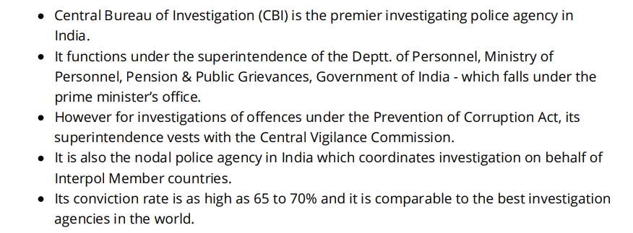
Other National level Agencies
CBI: Introduction

Slide 69
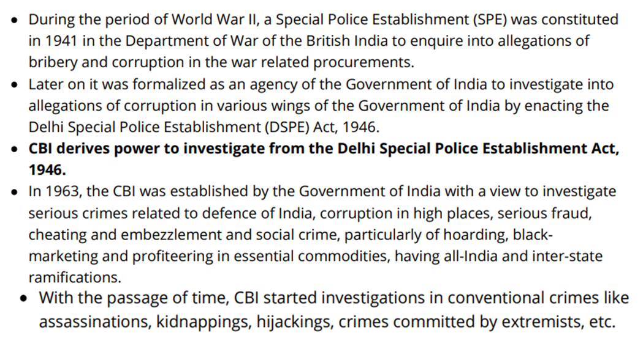
CBI: History

Slide 70
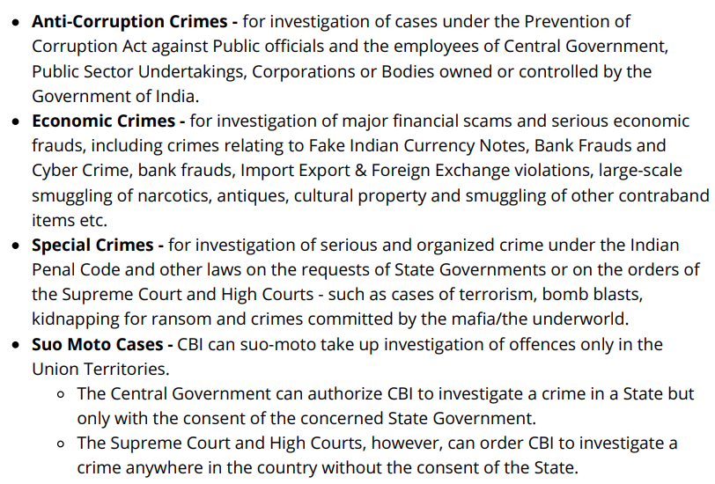
CBI: Function Areas

Slide 71
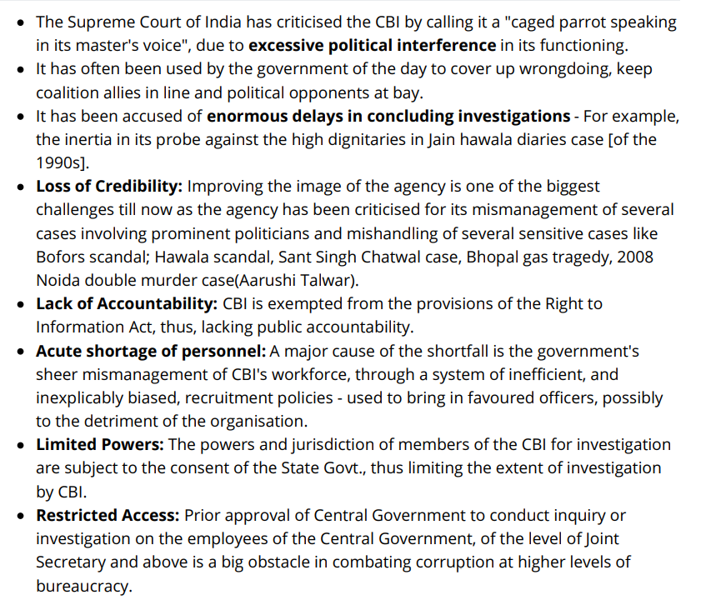
CBI: Challenges

